Slide 1
Hotel Booking Deal
Presented By-
Aman Jain
B.Tech CSE (A)
5th Semester
Presented To-
Mr. Devendra Kumar Mishra
Assistant Professor
AUMP

Slide 2
What is HBD(Hotel Booking Deal)
It is program which helps user to get satisfactory
Decisions for booking rooms.
When any user wants to book rooms in hotels or resorts, The description is given with the price related to that but the problem is that the user does not know weather the deal he is getting is acceptable or not.

Slide 3
Materials and Methods
Python
Machine Learning
AWS Database Server
Tkinter
MongoDB
Database

Slide 4
Methodology
Valid Authentication
Connection with Database with Queries
Graphical User Interface

Slide 5
Pages Included
Front Page
Login Page
Registration Page
Page for Filling Hotel Info.

Slide 6


Slide 7
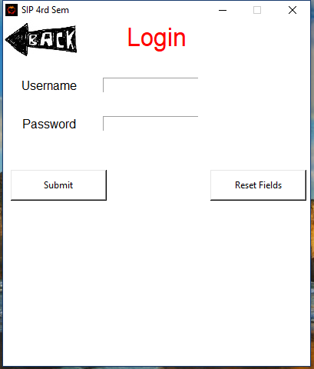
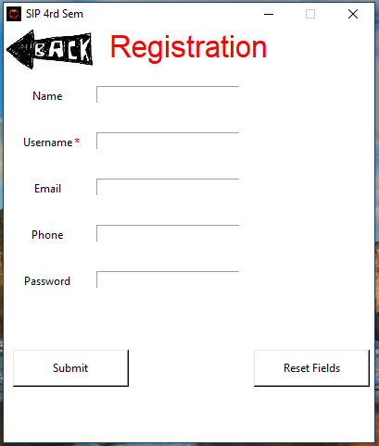

Slide 8
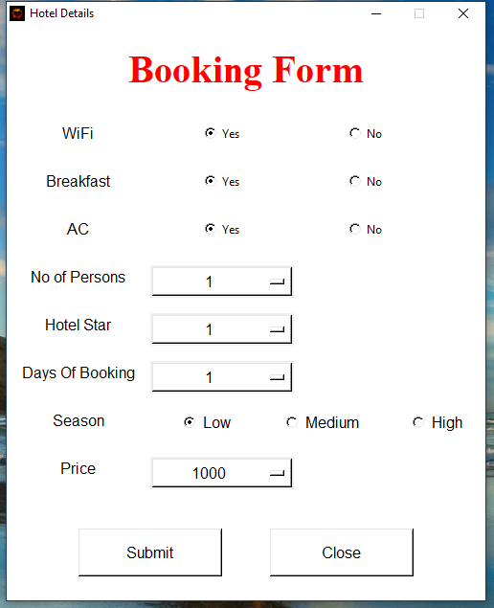

Slide 9
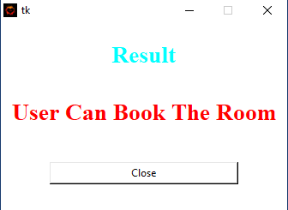
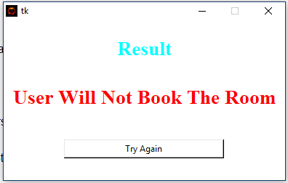
Results

Slide 10
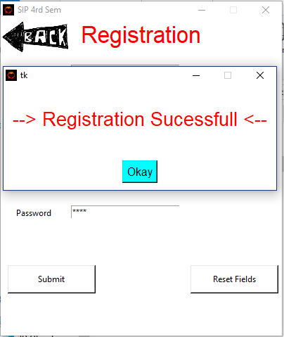
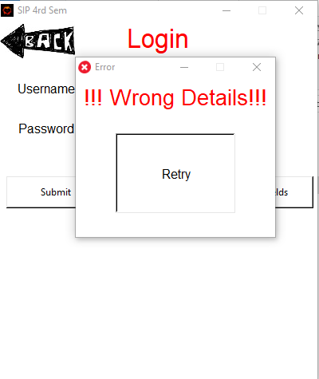
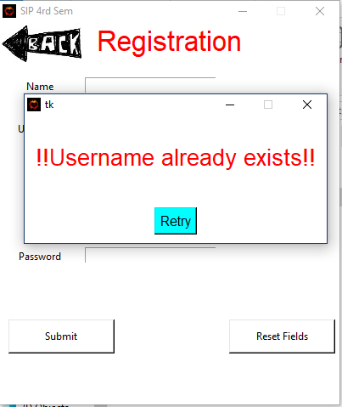

Slide 11
Future Aspects And Benefits
Reduce Confusion
Saves Time
Easy to Use
Portable
Plateform Independent

Slide 12
THANK YOU

